Slide 1
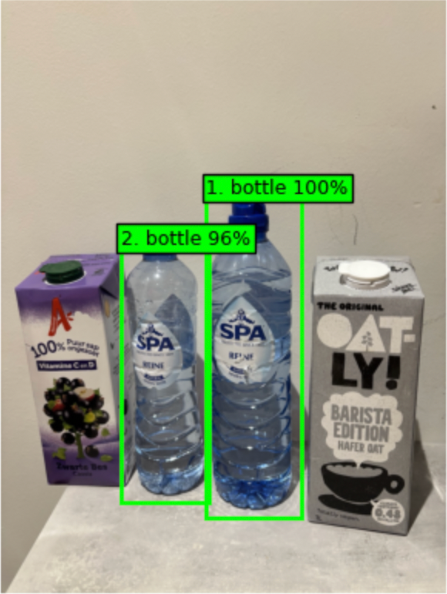
WEEK 7 / COMPUTER VISION
Bottle Count
Counting bottles from a phone photo
Rayna Jong
AI for Good / Solo workshop resit
RAYNA JONG / BOTTLE COUNT
01
Notes:
I tested whether a café worker could use a phone photo to get a quick count of the bottles on a counter. The notebook also shows boxes so the worker can check the result.

Slide 2
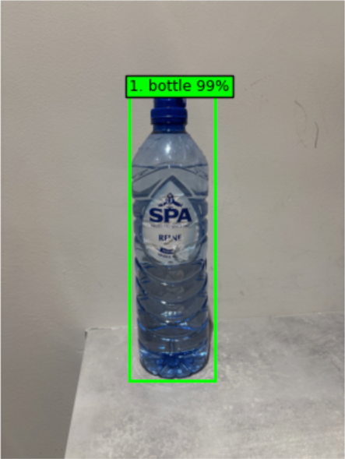
WEEK 7 / COMPUTER VISION
How the notebook counts bottles
1. Upload a photo
The notebook corrects the photo orientation and converts it to RGB and then to a tensor.
2. Find the bottles
Faster R-CNN with MobileNetV3 predicts a box, label and confidence score for each detection.
3. Count the boxes
Only detections labeled bottle with a score of 50% or higher are counted.
RAYNA JONG / BOTTLE COUNT
02
Notes:
The pre-trained detector finds objects and returns a box, a label and a confidence score. I filter for the bottle label and count the boxes that reach the confidence cutoff.

Slide 3
WEEK 7 / COMPUTER VISION
Ten photos and a manual count
What I photographed
Plastic and glass bottles, a seven-bottle lineup, overlapping bottles, different angles and dimmer light.
09_mixed_2.jpg
2 bottles with 2 cartons
How I recorded the ground truth
I counted the visible bottles by hand and put the count at the end of each filename.
10_cartons_0.jpg
How I used the cartons
0 bottles with 2 cartons
I included cartons next to bottles and on their own to check whether the model would count them as bottles.
RAYNA JONG / BOTTLE COUNT
03
Notes:
I took ten photos at home and counted the visible bottles in each image before running the model. The final number in each filename is the ground truth.

Slide 4
WEEK 7 / COMPUTER VISION
Results at 50% confidence
10 / 10
0.00
photos with an exact count
mean absolute error in bottles per photo
Example
Manual count
Model count
Seven-bottle lineup
7
7
Bottles beside cartons
2
2
Cartons only
0
0
RAYNA JONG / BOTTLE COUNT
04
Notes:
For each photo I took the absolute difference between the manual count and the model count. Averaging those differences gives a result in bottles per photo. All ten counts matched on this set.

Slide 5
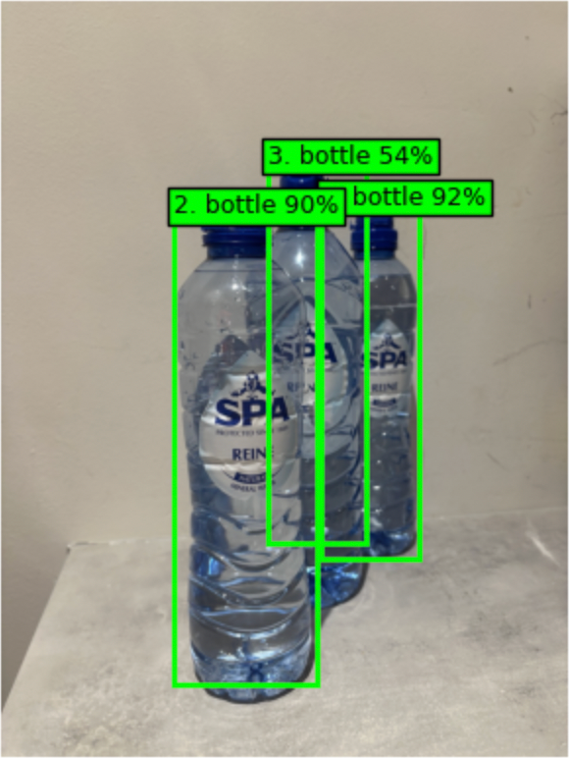
WEEK 7 / COMPUTER VISION
What changes at 60%
3 bottles by hand
50% cutoff → 3 counted
60% cutoff → 2 counted
The middle bottle scored 54%, so the higher cutoff drops it. A 58% detection also drops out in the spaced photo.
At 60%, 8 of 10 counts match.
RAYNA JONG / BOTTLE COUNT
05
Notes:
At 50 percent the overlapping photo gives the right count. The middle bottle has a confidence score of 54 percent, so a 60 percent cutoff filters it out. The spaced photo has a separate 58 percent detection that is also filtered out. This leaves eight exact counts out of ten.

Slide 6
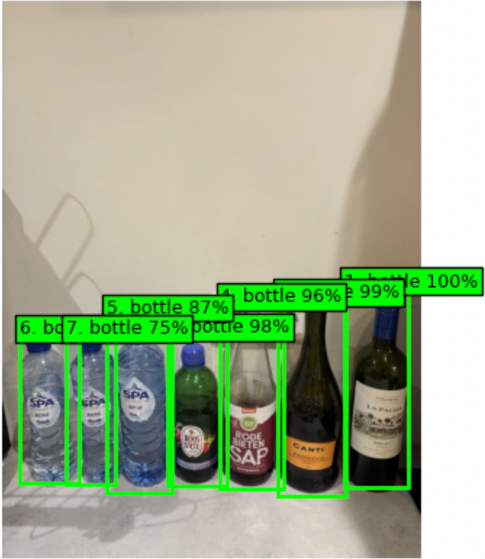
WEEK 7 / COMPUTER VISION
Demo and practical limits
Demo photo
The notebook drew seven boxes and returned a count of seven.
Where it could fail
Crowded shelves, strong reflections or bottles hidden behind others could lead to missed counts.
How a café worker can use it
Check the boxes against the photo and recount before updating stock if anything looks off.
RAYNA JONG / BOTTLE COUNT
06
Notes:
For the demo, open the saved output in the notebook and point to the seven boxes. I only tested ten photos at home. A wrong count could lead to incorrect stock records, so staff should check the boxes and recount if needed.

